Slide 1
The Zen of Coding
Day 1
Notes:
hey everyone, welcome to the first day of the bootcamp!
super excited to get started and get to know everyone!
before we get started - just want to throw it out there that I’m actually a little jealous
there wasn’t anything like this in the BS program, and you all will have a lot of practical, applicable knowledge
really cool curriculum, awesome resources -
your github contributions and portfolio will look much better than mine once you’re finished :)
so let’s jump right in

Slide 2

Quick Introductions! (30 seconds)
Name
Location
Background (Career, Education, Interests)
Why learn web development?
Fears about class?
Notes:
Students
TAs
NEXT
take notes to address fears at the end
why learn?
switch careers, flexible schedules
information science - good complement
better understanding of technologies of website I’m supporting
fears: getting everything in on time/balancing things
kids
not getting a job
don’t have confidence

Slide 3
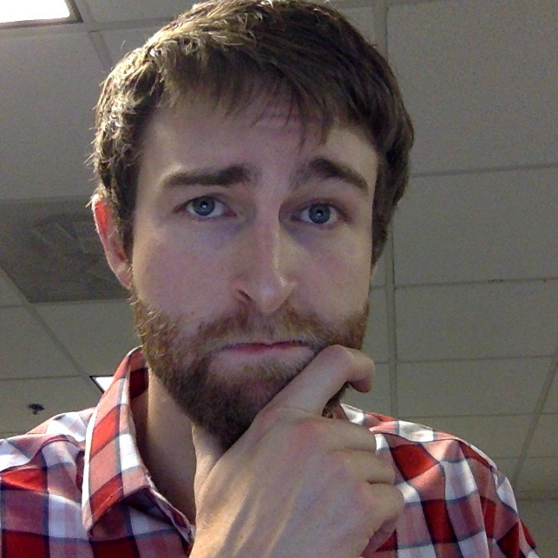
Instructor = … ?
Nick Bartlett
BS in Computer Science and Mathematics at UNC
MS Candidate in Computer Science from UNC
Over 8 years coding, does web development every day and loves it.
LOVES teaching
Likes to rock climb, bike, and generally do things outdoors when he finds the time.
Notes:
and a little about myself
I have a BS in Computer Science and Mathematics, just finishing my MS in CS hopefully this month.
been coding for 8 years, but for the first few I was a little off and on - when I started I honestly didn’t love it, it was pretty far removed for me.
but then I got in to web development
LOVE teaching, do it at work regularly, TA’d through college, this is as an exciting an experience for me as it is for all of you
when I have free time …
So, I’ve worked on various software and websites, but most recently
NEXT
IBM’s digital marketplace

Slide 4

Some Cool Stuff I Made…
Notes:
One thing I’ve built (and poured a lot of time and effort in to) is IBM’s universal digital marketplace
sell cloud/on-premise software and hardware
over 40k pages
over 60 countries and 15 languages
lots of interesting challenges and trade-offs.
use a lot of the same technologies you’ll be learning in this course
anyone have any questions about me, the TAs, or anything else before moving on?
NEXT

Slide 5
The Path of Learning

Slide 6
Common Student Goals
“To land a solid career.. and be able to support a family.”
“Hope to make something of myself one day…”
“An opportunity to be more creative in my day-to-day work.”
“…to get a better paying job.”
“I want nothing more in the entire world than to be a game designer.”
“Change careers and become a web developer.”
“…to build mastery. To learn a skill that I haven’t yet explored.”
“[a chapter] better than the last.”
Notes:
we heard some of the reasons you all joined the program earlier
these are all really solid reasons, and we’re here to help you meet your goals NEXT

Slide 7
Your Goal = Our Goal
As instructors,
We take your goals very, very seriously.
Notes:
as such, we take your goals very seriously, and so should you.
very seriously.
that’s why we’re here, and we want to help you accomplish what you’ve set out to do. I can’t stress enough how much we want you all to succeed.
NEXT

Slide 8
Support Team
Our Promise:
If you’re willing to put in the time – and you take our advice, we’re here to help you 100% of the way.
This goes for everyone working behind the program:
Instructors
TAs
Student Success Team
Career Coaches
Everyone Else…
Notes:
We're here to support you 100% of the way to really help them achieve their goals.
IF you ever have any questions or concerns, reach out to any of us - you have a wide network of resources available to you
however, the biggest obstacle you will likely encounter is yourself
NEXT

Slide 9
Nothing Comes Easy…
As students, you face two HUGE obstacles
Notes:
learning to code is tough, intimidating, and frustrating at times.
forget stories about people learning to build apps in one week
Coding is hard. It will take time. There is no way around that. and we want you to be good at it.
the first major obstacle is NEXT the great confusion

Slide 10
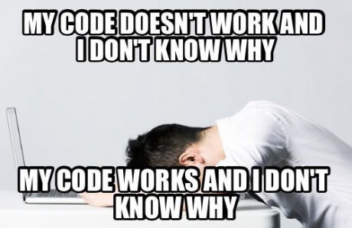
Obstacle #1 – The Great Confusion
Notes:
you will likely doubt yourself. you will be confused.
coding can be confusing, and the barrier to entry can be pretty steep. EVERYONE experiences this.
this is perfectly normal, and a part of learning.
I started there, everyone who codes was there at one point.
you have the initiative, you’re here, and you have what it takes.
on top of that, you have us, so basically you’re already at an unfair advantage.
NEXT

Slide 11
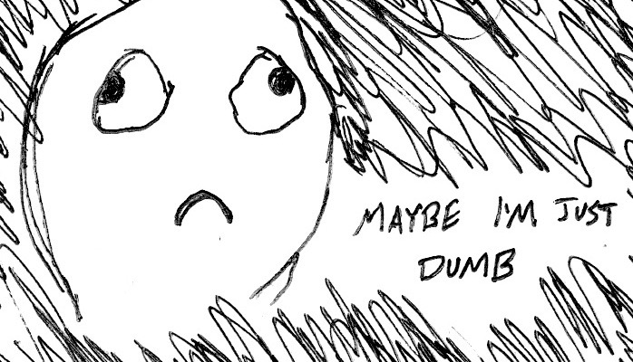
Obstacle #2 – The Great Doubt
Notes:
"learning" is "frustrating". It's a process. But stick with it. remember you’re not dumb - if you’re struggling to grasp something it’s just a lack in experience, and can be overcome with patience and effort.
that being said NEXT

Slide 12
Nothing Comes Easy…
Learning Coding Requires Two Things:
Persisting in the face of something that feels incredibly hard and confusing
Maintaining the self-confidence necessary to believe that you CAN DO THIS
Notes:
you’ll need to be persistent. coding is hard and confusing at times, and it can take a lot of effort to power through the confusion
however, if you keep in mind that everyone else was struggling the same way at some point, and remember that you put yourself here and believe you can do it you can power through.
as always, use what resources you have available to you.
NEXT

Slide 13
Learning is “Frustrating”
“You can’t tell whether you’re learning something when you’re learning it—in fact, learning feels a lot more like frustration.”
“What I’ve learned is that during this period of frustration is actually when people improve the most, and their improvements are usually obvious to an outsider. If you feel frustrated while trying to understand new concepts, try to remember that it might not feel like it, but you’re probably rapidly expanding your knowledge.”
Phillip Dickey, Author of Write Modern Web Apps with the MEAN Stack: Mongo, Express, AngularJS, and Node.JS
Notes:
and I can’t stress enough how important it is to work through the frustration.
just don’t take it personally, be patient and persistent when working through problems.
everyone here is capable and should be confident that they’re learning and giving it their best effort.
the feeling when you solve that problem or overcome a particular concept is nearly unparalleled.
NEXT

Slide 14
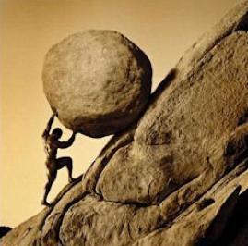
Advice for the Journey
Throughout this course, always remember to:
Work Hard!!
Notes:
so, in short. remember to always
work hard! a lot of these concepts can be difficult, but give it your all, and you’ll see how rewarding and fun this can be NEXT

Slide 15
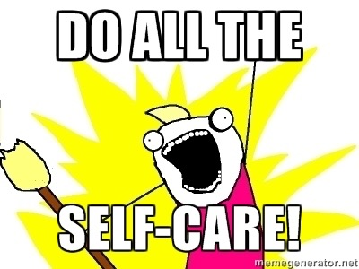
Advice for the Journey
Throughout this course, always remember to:
Work Hard!!
Appreciate your successes
Notes:
take a step back, realize how far you’ve come occasionally
recognize where you are, appreciate when you do something awesome, which you will, often.
NEXT

Slide 16

Advice for the Journey
Throughout this course, always remember to:
Work Hard!!
Appreciate your successes
Trust yourself
Notes:
above all, trust yourself. you’re all smart, capable and want to learn this
That’s pretty much all to say about learning and the journey.
Remember that there’s a lot to know in this field; I’m sure you all will ask me questions that even I don’t know.
but that’s part of the appeal - I learn new things every day and it keeps me interested and engaged, and the problem solving aspect is always really fun.
NEXT

Slide 17
Course Structure
Notes:
before we get in to the technical topics today, let’s take a second to talk about course structure
NEXT

Slide 18
Daily Schedule
For each class we’ll run through the following:
Set Objectives
Brief Background Lecture
Watch Me / Coding Demos
Code Discussions
In-Class Exercises
Project Work
Notes:
talk about what the objectives are for the class
brief background lecture
I’ll do some coding/demos regarding the background, we’ll discuss it
however: NEXT
learning to code requires coding

Slide 19
Daily Schedule
For each class we’ll run through the following:
Set Objectives
Brief Background Lecture
Watch Me / Coding Demos
Code Discussions
In-Class Exercises
Project Work
The Super Important Stuff!!!
i.e. Always be coding!
Notes:
learning to code requires coding (not just sitting through lectures) -- so this program will very quickly become “code-centric".
one of the take aways here is that the only way you’ll become good at coding is to do it yourself
however, one last thing: this course, and software engineering/development in general, is a team exercise (rarely work alone, you’ll take advantage of other people’s open source code, etc.)
as such, it is your responsibility to grasp this material, but you’ve failed if your neighbor doesn’t.
we’ll have a lot of collaborative exercises, and you’ll talk to your partner about this kind of thing often. helping someone else understand is the best way to solidify your own knowledge is to teach, so it’s in your best interest anyway
NEXT

Slide 20
Today’s Schedule
Students will get to know their classmates, Instructor, TA's, and Support Team.
Students will resolve any issues regarding pre-work and computer setup
Students will understand the course structure.
Students will learn common Terminal (Mac) / Git Bash (Windows) commands to set up your file and folder structures.
Students will be able to use common Terminal (Mac) / Git Bash (Windows) commands for web development.
Students will be able to set up a basic HTML document.
Notes:
so, that being said, let’s talk about today’s objectives
any questions about what the plan is?
cool, so let’s talk about tools you need to have set up to succeed
NEXT

Slide 21
Pre-Work

Slide 22
Software Checklist
At this point, you should have each of these installed:
Slack
Sublime Text 3
Git for Version Control
Git Bash (Windows) or Terminal (Mac)
Heroku Toolbelt
MySQL
Heidi SQL (Windows) or Sequel Pro (Mac)
Google Chrome
Notes:
you should have all of the tools and software applications
if you ran in to any snags we will work with them to confirm everything is set up over the next 35 minutes.
it’s important that we get all of this set up so that you can effectively participate!

Slide 23
Accounts Checklist
You should also now have accounts for:
GitHub (with SSH Integration)
Heroku
LinkedIn
Stack Overflow
Twitter
Notes:
you should also have accounts for the following:

Slide 24
a
Let’s do some quick checks of the following
Sublime Check
Git Bash / Terminal Check
Git Check
Heroku Check
Notes:
Instructor: Walk through each of the following "test" processes to confirm whether students have successfully installed the right software. Have them follow along with you in class and raise their hand for a TA if they are missing something.
Slack
Easy to show. Just open Slack. But make sure students have it installed locally and are not using the web client.
Sublime
Easy to show. Just open Sublime. Make sure they can do so as well.
Terminal / Bash
For Mac users. Have them open their Launcher and search for Terminal.
For Windows users. Have them open the program called Git Bash.
Node
While in terminal or bash, simply write the word: node then hit enter. Your cursor should change
Then type 1+1 and hit enter. If node is installed it should translate the answer to 2.
Then type ctrl+c to exit node.
Github and Git
Confirm that students all have an account on GitHub through a show of hands.
Those that do not have an account should immediately create one.
While still in terminal or bash, type git and hit enter. If Git is installed it should trigger a series of lines about Git.
confirm GitHub accounts tied to local Git using SSH authentication
have them type the following: ssh -T git@github.com.
It should then ask for a passphrase (tied to your local account). Provide it (letters will not appear) and hit enter.
If you are authenticated, it should provide a welcome message.
Ask via a show-of-hands how many students did / did-not get the welcome message.
point them to this link Generating an SSH Key - GitHub. https://help.github.com/articles/generating-an-ssh-key/
Prework - help students
Walk around and help students as necessary but keep track of time!
Prework - Heroku
Once Git is covered ask how many students were able to create an account on Heroku. Show them your own Heroku account online as an example.
Then have them once again go into Bash / Terminal and type the word `heroku`. If they are properly setup, it should provide a set of information about Heroku.

Slide 25
On the Modern Web
Notes:
7. BREAK (15 min)
8. Instructor Do: On the Modern Web (7 min)
so, let’s talk about the modern web and web development today.

Slide 26
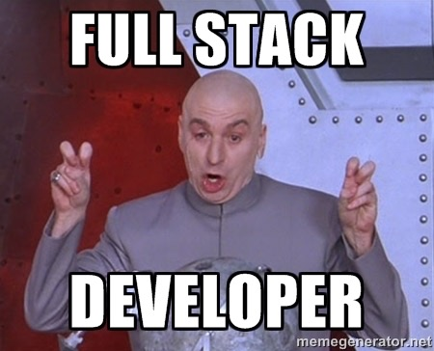
Full-Stack Development?
Notes:
“what do you think Full-Stack Development is?”.
Point out that they are all enrolled in a Full-Stack Development program... so it probably matters.

Slide 27
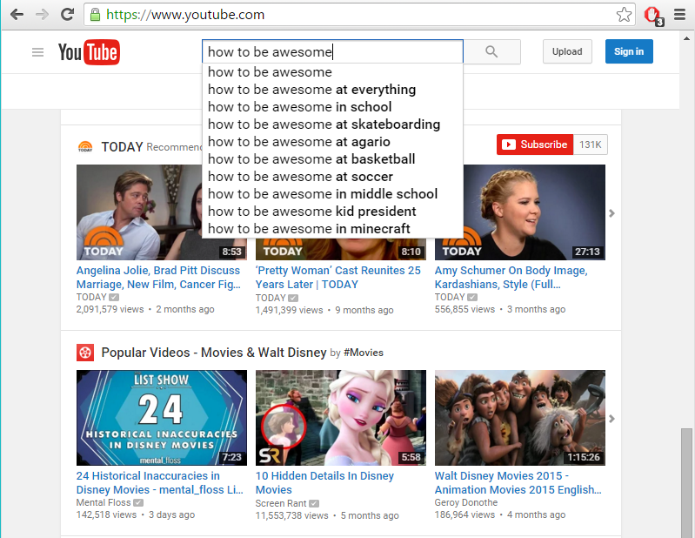
The “Magic” of YouTube
Notes:
Let’s walk through a basic youtube search
the process of retrieving a video from Youtube requires two things: - the Graphic User Interface (GUI), which responds to what you type
code on the server side that is able to search through databases, find the right video, and send it to the GUI
This is the separation of the “back end” and “front end” NEXT

Slide 28
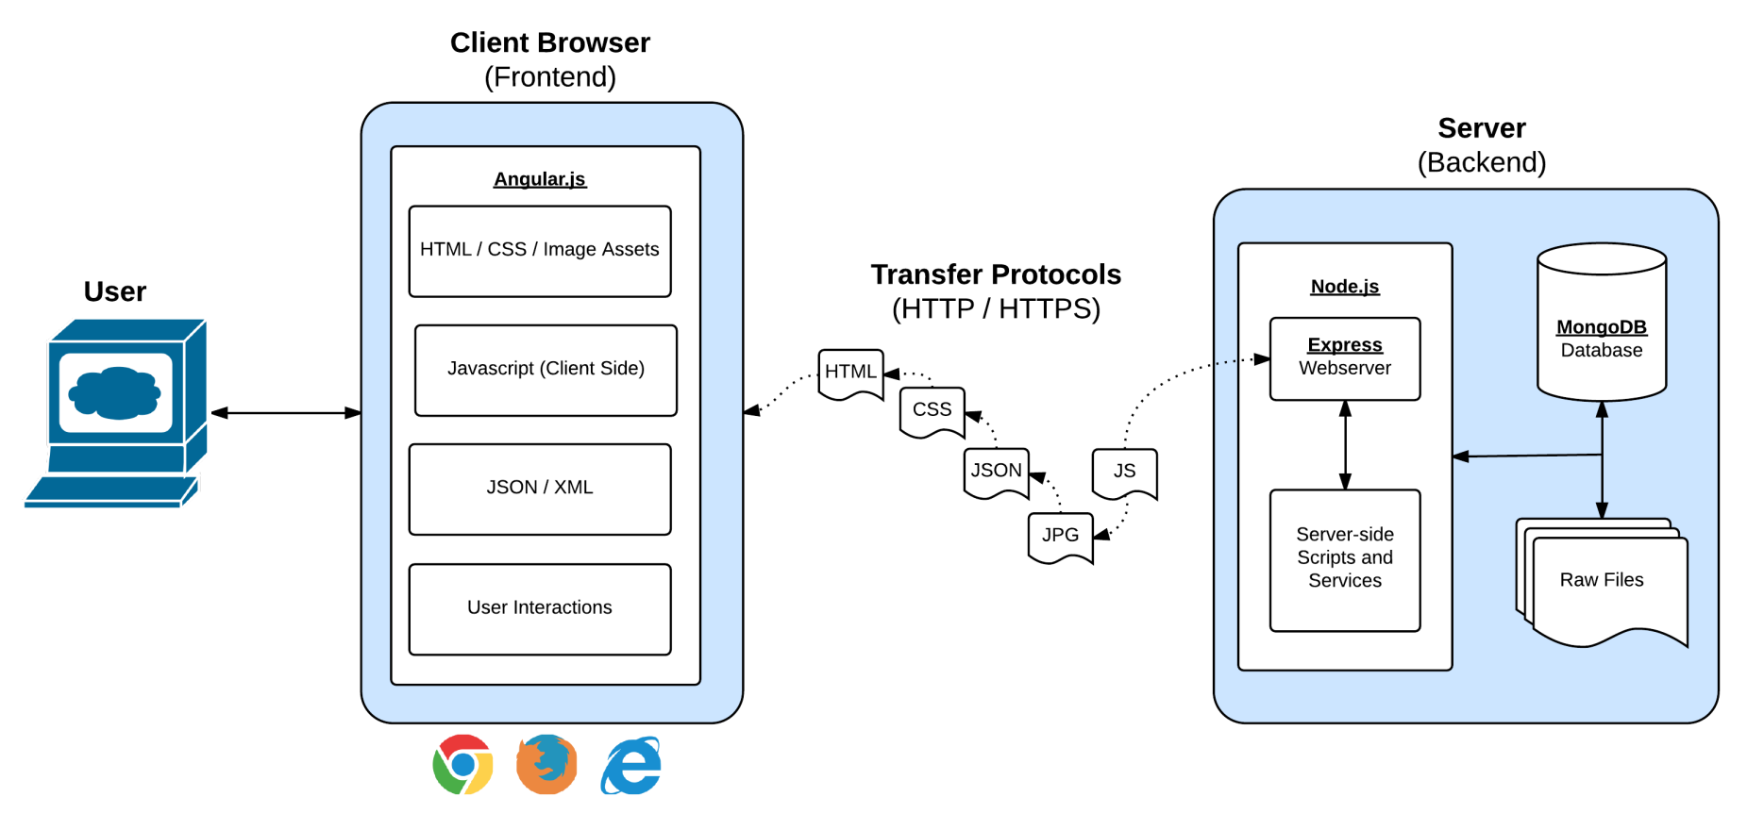
Full-Stack Development
In modern web applications there is a constant back-and-forth communication between the visuals displayed on the user’s browser (frontend) and the data and logic stored on the server (backend).
Notes:
it’s okay if you don’t understand everything on this slide right now; by the end of the course you will.
This is a demonstration of what what we just did looks like
here the GUI is the Client Browser, or the front end which displays the videos you want to see using various technologies
the back end is the server - the piece that gets the videos you’re looking for from the database and sends them to the Client Browser
again, websites are about creating code for both this “frontend” and “backend” NEXT

Slide 29
Full-Stack Development
Full-Stack Development is the concept of building every aspect of the web application – from the visuals and interactions, to the data transfer and processing.
Notes:
which leads us to what it means to be a “full stack developer”
as a developer of web applications, you need to understand every aspect of the web application, meaning you need a good understand of both the back and front end technologies
any questions so far?
so … what is the front end of an application?
NEXT

Slide 30
Full-Stack Development
The Browser
Dev Tools
Server Side
HTML
CSS
JavaScript
jQuery
Bootstrap
SEO
Heroku
Git
GitHub
Templating Engines
Sessions
Writing tests
Node.js
Express.js
Creating APIs
MVC
User Authentication
ORM (Sequelize)
Meteor.js
Databases
MySQL
MongoDB
API Interaction
APIs (Consuming)
JSON
AJAX
Real Time Cloud Database via Firebase
Algorithms
Design Patterns
CS Fundamentals
Cutting Edge Development
React.js
Notes:
That being said, there are countless (not literally) technologies that can be used to build web applications, and many that must be used.
As a full stack developer, you should by the end of this bootcamp have a great understand of all of these and more.
That being said, NEXT let’s get cracking!

Slide 31
Let’s Get Crackin!
Notes:
“Let’s get cracking”
We’re going to jump directly in to how to use a terminal.
Why? It’s an excellent tool for automating actions, scripts, and generally allows you to interact more quickly and efficiently with the file system and your code.
I’ll walk through a few examples, and you can follow along.
After, we’ll give you some time to work in the terminal yourself.

Slide 32
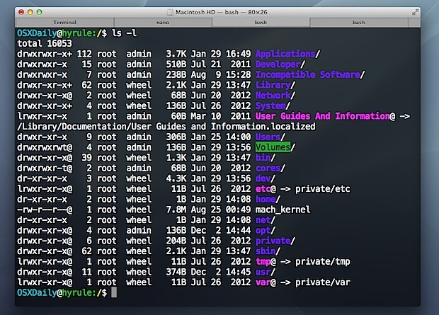
Intro to Console / Terminal
Notes:
So let’s open a terminal.
we have a number of commands to walk through.
it may be a little intimidating, but honestly they’ll become second nature moving forward

Slide 33
INSTRUCTOR DEMO
Instructor: Demo
(1-ConsoleCommands)
Notes:
cd (changes directory)
cd ~ (changes to root directory)
cd .. (moves up one directory)
ls (lists files in folder)
pwd (shows current directory)
mkdir (creates new directory)
touch (creates a file)
rm <FILENAME> (deletes file)
rm -r <FOLDERNAME> (deletes a folder, note the -r)
open . (opens the current folder. MAC SPECIFIC)
open <FILENAME> (opens a specific file. MAC SPECIFIC)
explorer <FILENAME> (opens the specific file. BASH SPECIFIC)
explorer . (opens the current folder. BASH SPECIFIC)
any questions? let’s

Slide 34
> YOUR TURN!
Activity: Get Situated | Suggested Time: 1 min
Assignment:
Make a folder on your desktop named code
Put all of you code that you do inside of that folder
Best Practices:
Always use lowercase for folder and file names
Never put in spaces in your folder and file names
Use dashes to separate
Notes:
Your turn!
In general, we’ll have you coding, like I said.
So let’s put these terminal commands to the test. Some up front best practices:
…
So here’s your assignment NEXT

Slide 35
> YOUR TURN!
Activity: Console Commands | Suggested Time: 12 min
Assignment:
From the Terminal / Console and using only the command line, create:
A new folder with the name of first_day_stuff
A new HTML file with the name of first_day.html
Open the current folder containing the new HTML file.
Bonus:
Create multiple directories/folders with the names one_folder and second_folder in one command.
Create multiple files with the names one.html and two.html in one command in the first_day_stuff directory.
Notes:
using command line only, you’re going to create a folder, html file, and open the folder with the HTML file.
we’ll walk around and help out, and talk to your neighbors to make sure they are on the right track
-
(I’ll paste this in slack as well)
at the end, have someone paste their bash history in slack, talk about what they did, etc.

Slide 36
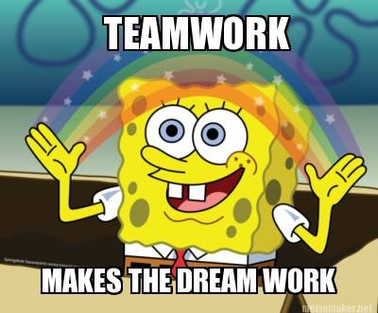
Intro to Console
Discuss with Neighbors
Notes:
discuss the process of creating files, removing files, etc. - why you would want to do it, how, etc.
explain to one another a high-level definition of "full-stack development”.
Briefly have students explain the answers back to you.
call out some people (if no-one answers)
NEXT

Slide 37
Hello, HTML
Notes:
now that we understand the terminal and can create `.html` files through it, let’s talk about html

Slide 38

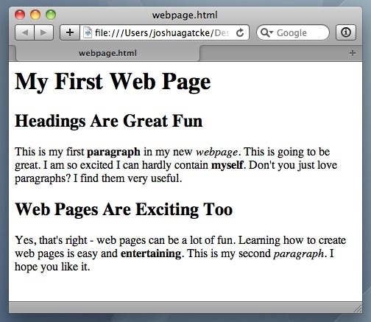
<title> Intro to HTML </title>
HTML is one of the three base languages behind every single website.
It defines all of the basic content and a bit of formatting.
Notes:
HTML is required for any website you’ll ever build - it is a cornerstone technology in the builtin of web pages
It stands for Hypertext Markup Language, which gives you a hint at what it does -
it is a language which defines the markup on the page - essentially, all of the content
things like images, links, text, paragraphs
you can also do some basic formatting of this content using HTML as well.
Let’s take a look at a basic example of creating an HTML page with some of these elements
<!DOCTYPE html> must be the first thing
is not an HTML tag; it is an instruction to the web browser about what version of HTML the page is written in.
<head> container for metadata - document title, associated styles, scripts, and other information
<body> document’s body - represents the content of an HTML document, can only be one
<h1>, <h2>, <p>
links in html are created using the ‘a’ tag, which stands for ‘anchor’. this is because the tag originally was used only to link within documents. you can use this to link out of documents now.
To successfully link to something, we have to introduce the idea of attributes.
elements in HTML can also have attributes these are additional values that configure the elements or adjust their behavior in various ways
<a>, <img> tags
There are hundreds of tags which allow you top create elements (which encompass the opening and closing tags and the associated content)
these are some of the most commonly used, but there are many more that provide various content and structure to the document
any questions about any of these tags so far? okay, so what does an ‘a’ tag do?
NEXT

Slide 39
> YOUR TURN
Assignment:
In a new HTML file, create the basic structure of an HTML document and include the following in it:
DOCTYPE declaration
Head tag with a title tag
H1 tag with a title of your choice
Embed an image
Create the following three links on your page:
One link that is target="_blank" so that it opens a new tab when clicked on.
Make the second link bold.
Make the third link a placeholder so it goes nowhere.
Bonus:
Create an ordered list of steps to make a sandwich.
Create an unordered list of 5 bands/musicians you like.
Create a table with 2 columns (animal class, animal name) and have 4 rows of animals
Use an alternate way of separating links without line breaks.
Embed a Youtube video of your favorite band/musician.
Notes:
alright, your turn!

Slide 40

<title> Intro to HTML </title>
How’d it go?
Notes:
you all just built your first HTML file (if you hadn’t built one before).
You could stop today and say you’ve done web development before, but that would be a bit misleading :)

Slide 41
Homework!

